Slide 1


Developing a Framework for Platformer Type Game
Using C# and WinForms
Notes:
Welcome to our new course on Python.

Slide 2

Learning Objective
Develop a platformer game using win form and Object Oriented Programming.

Slide 3
Assessment
This project carry 20% marks toward the Theory Course. 40% marks toward the Lab Cours.

Slide 4
How to Pass the Project:CODING
Project Task shall be assigned daily basis. You need to complete the task using git hub repository and through daily commits.

Slide 5
How to Pass the Project:Documentation
2. Every step require a documentation that include
Clearly mentioned Problem statement.
Procedural Solution
Its sudo code/Algorithm
Demerit of the Solution
code
OOP.
Design Decision if multiple OOP Way exist
UML Diagram
Merit/DeMerit
Code.

Slide 6
Setting up Environment.
Let make our view bit attractive.
Setup the background of the form.
Add picture Box that shows the main player
Note: you need to have png for the background and main player.

Slide 7
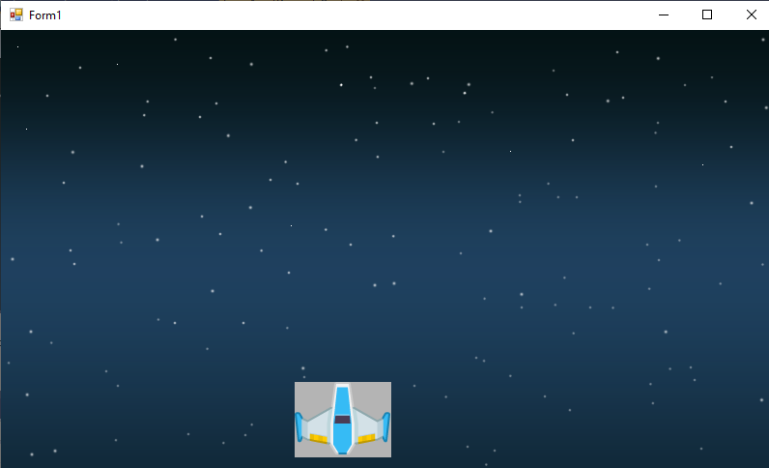
Setting up Environment.

Slide 8
Problem: Taking Asynchronous Input
Now you need to make the playership move with Arrow Keys.
We have already used EZInput. So You need to install NUGET Package.

Slide 9
Problem: Game Loop
Where to write code for KeyBoard Input ?

Slide 10
Problem: Game Loop
Where to write code for KeyBoard Input ?
We need to take a continuous input from the user. Therefore, we need to add timer control which will run its event after some time.
Therefore, we shall add a timer, set it interval time to 500 milliseconds and write the code inside the Tick Event of the timer

Slide 11
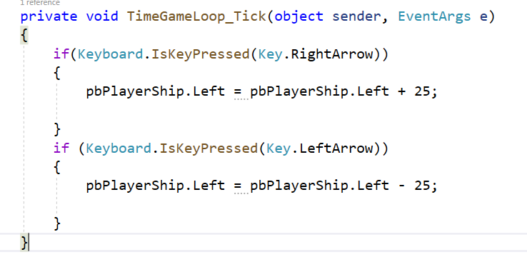
Problem: Game Loop

Slide 12
Problem: Game Loop
We have implemented the player ship movement but there are two problems in it
Picture box showing filled area
Game is jittering.

Slide 13
Problems
We have implemented the player ship movement but there are two problems in it
Picture box showing filled area
Game is jittering.

Slide 14
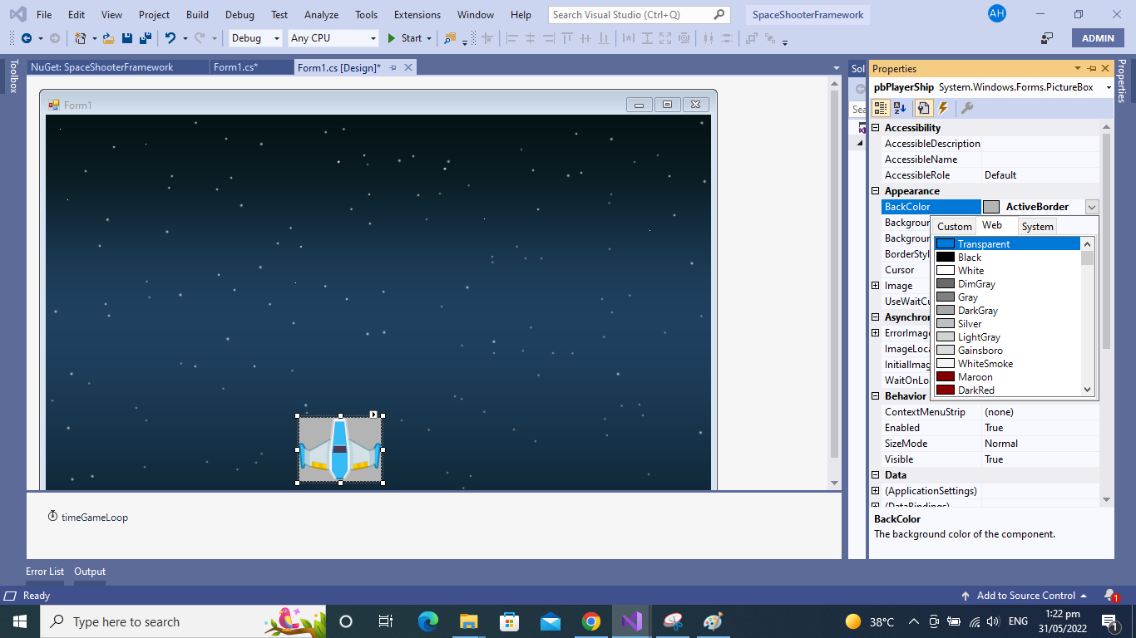
Problem: Transparent Background
Set the background property of image box to Transparent

Slide 15
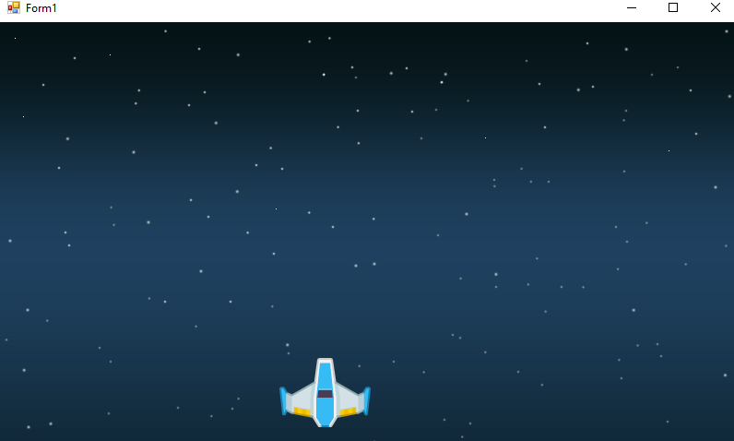
Problem: Game Jitter
Set the form doubleBuffer true to improve the rendering of the game.

Slide 16
Add Firing Behaviour.
How to add fire behaviour for the playership.

Slide 17
Add Firing Behaviour.
On spacebar press, we can create a pictureBox at runtime setup it location to the exactly the middle of the player ship and add into the list of fires so later on these fires may start moving.

Slide 18
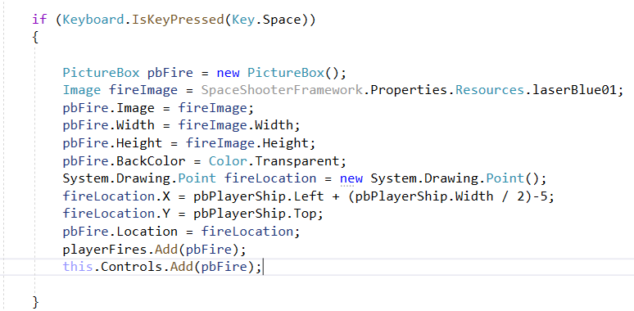
Setting up Fires.
In main gameLoop, add following code.

Slide 19
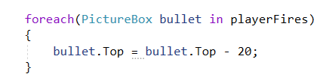
Moving fire Behaviour

Slide 20
Can you Highlight problem.

Slide 21
Can you Highlight problem.
Here, we are adding fires and moving even if they are out of context (screen), they live in memory and game loop keep processing it. Therefore, we need to remove them from list so they will be collected by gc.

Slide 22
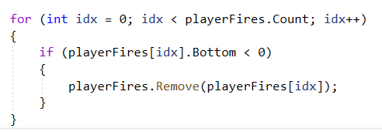
Removing Unnecessary Bullets
We can not use the foreach loop to remove from the current list. So we have to do it with traditional loop.

Slide 23
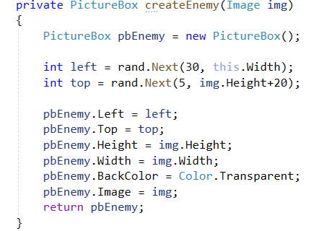
Creating Enemies:
We have to create multiple enemies therefore we can make create Enemy Function

Slide 24
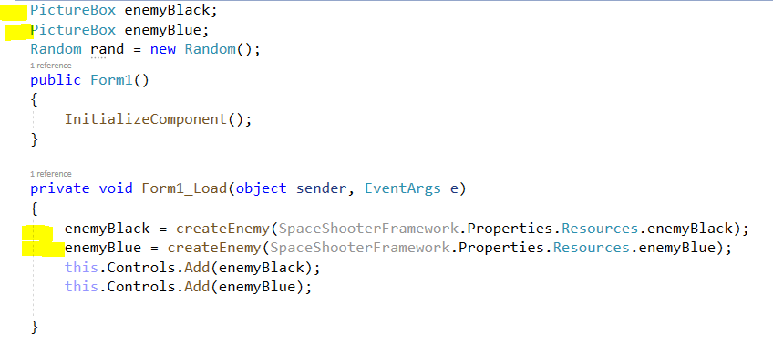
Adding Enemies:
At the moment, we call the function from load form event to create two enemies.

Slide 25
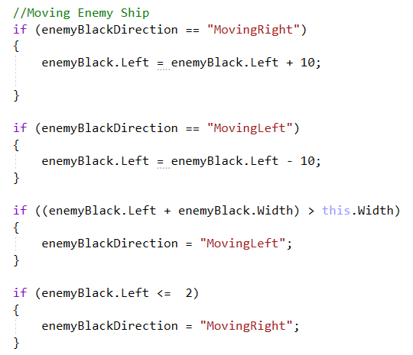
Moving Enemy
We want to move enemy from left to right and then right to left automatically. Let’s write the code

Slide 26
Moving Enemy
The code is for one enemy how to make it for two enemy but at the moment we do not want to use the classes ?

Slide 27
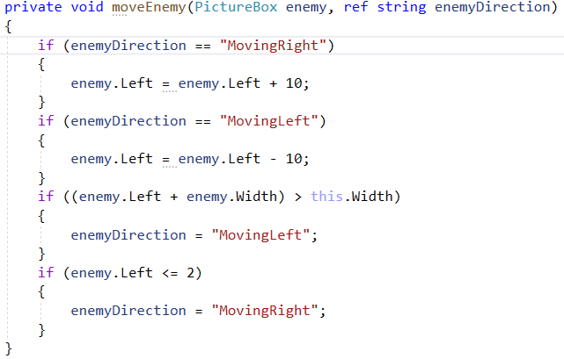

Moving Enemy
We can create a function that will modify enemy generically.

Slide 28
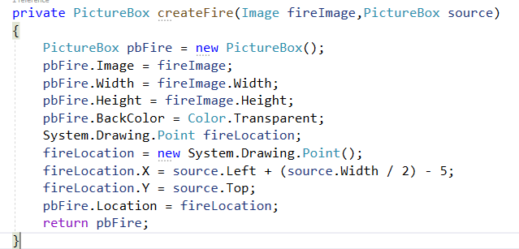
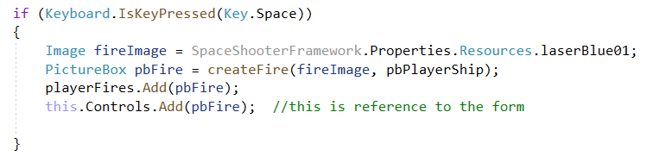
Making Fire Reusable
We need fire functionality for enemy as well therefore we have to make a separate function to create fire to reuse it.

Slide 29
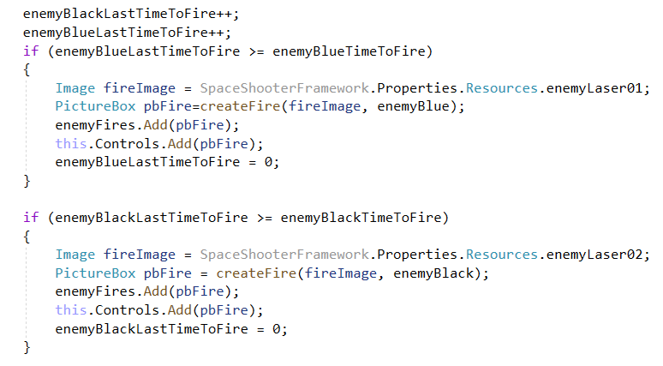
Creating Enemy Fire

Slide 30
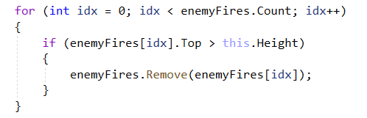
Removing the Fires from the List

Slide 31
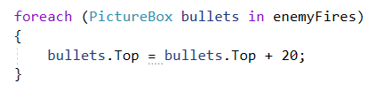
Moving Enemy Fires

Slide 32
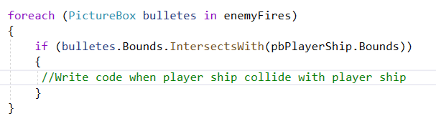
Identify the Collision
Now, we need to write the code that identify the collision between the enemy bullets and the player ship. How to do that ?

Slide 33

Player Health
We can show health to user with help of the progress bar control. We add the control right under the ship and move it with the playership

Slide 34
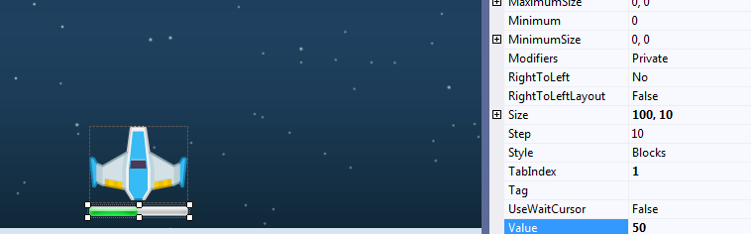
Player Health
There is an attribute of progress bar name value which shows how much progress bar should be filled

Slide 35
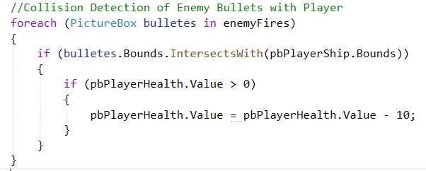
Player Health
So on collision, we shall decrease the player health by 10 points till the value of the progress bar is not zero

Slide 36
Player Health: Game Over
We need to game over when the health of the player get zero

Slide 37
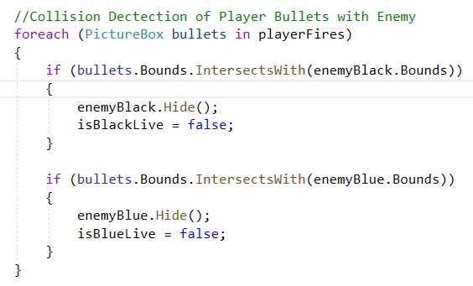
Destroy Enemy:
Similarly, we can destroy enemy when player bullet hit it. For simplicity we are destroying enemy at single bullet.

Slide 38
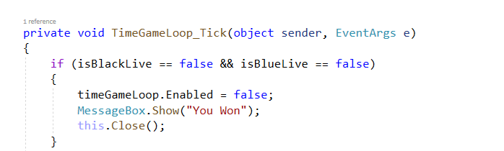
Destroy Enemy: Game Win
When all enemies are destroyed game should be won by the user. For that we can write the code.

Slide 39
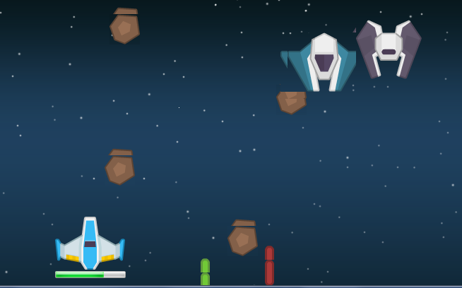
Adding Falling Meteoroid
Now we make our game a bit more interesting to add falling meteoroid.

Slide 40
Adding Falling Meteoroid
We want to generate meteorite after some time and want to generate these randomly.

Slide 41
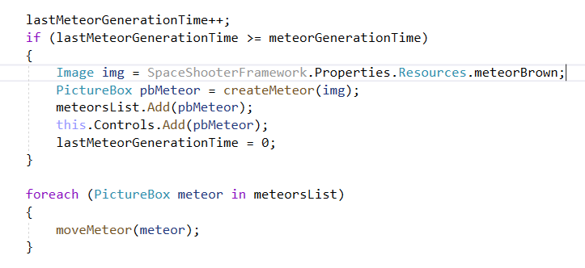
Adding Falling Meteoroid
We want to generate meteorite after some time and want to generate these randomly.

Slide 42
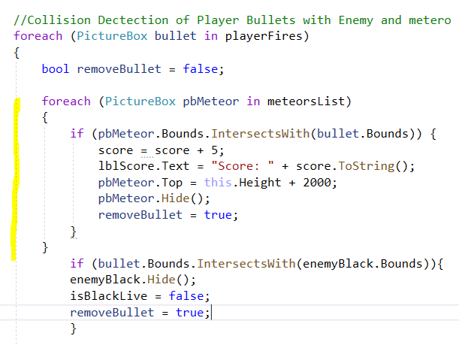
Adding Scoring Behaviour
Now, if the player’s bullet hit the meteoroid, we want to add 5 to score. Also, once bullet is hit to meteoroid it should be hide and removed from the list.

Slide 43
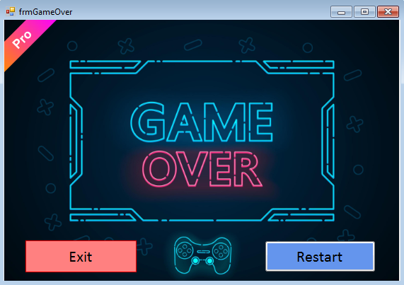
Now, we add the Game End Screen

Slide 44
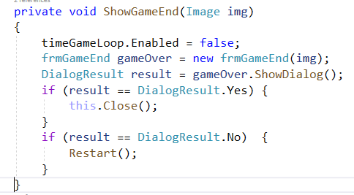
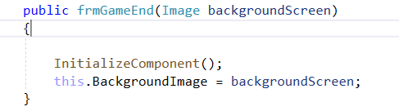
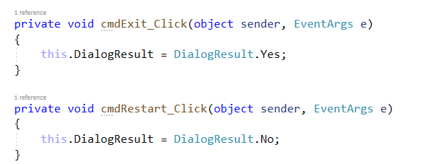
Show Game End Screen
We use dialogue box to show the game screen and use the DialogResult to decide what option user has chosen

Slide 45
Creating Playership Dynamically.
Before, looking into the code how to restart the game, we need to create player dynamically.
At the moment the player ship is created at design time but we have to create player ship through code so game can be restarted.

Slide 46
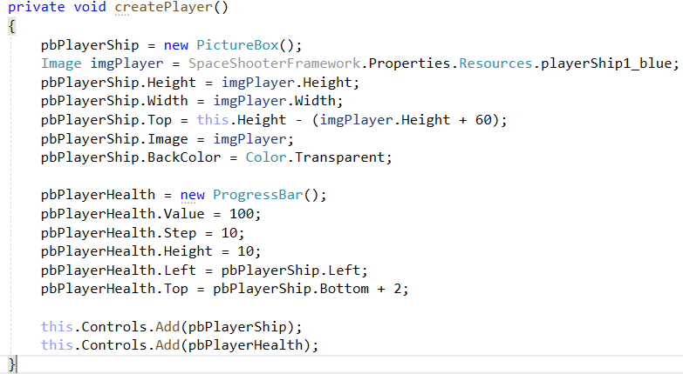
Creating Playership Dynamically.

Slide 47
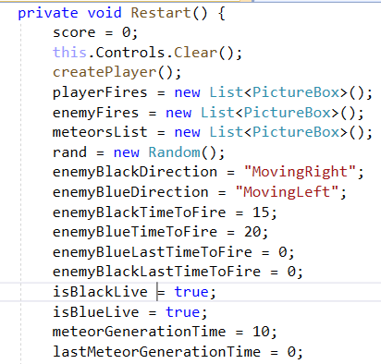
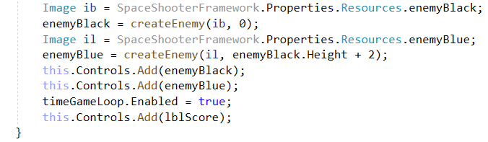
Implementing Restart.

Slide 48
Developing a Framework
Using C# and WinForms
Notes:
Welcome to our new course on Python.

Slide 49
What is Framework.
Here, In this context, framework is a line of code that has been written independently and can be re-used at multiple locations.

Slide 50
What is Framework.
For example, in every game, we write down code to move objects (some time with keyboard, some time move vertically, some time move right to left and then left to right).
If we write down this code to move objects once and then allow every other developer to reuse that code in his/her game without exposing the details of the code this is called framework..

Slide 51
What is Framework.
However, one may argue, this can we done through the simple OOP. Yes, framework is manifestation of OOP programming.

Slide 52
What is Framework.
Framework not only offers the re-usability but it should also offers two fundamental constructs
Constraints on the Development Side.
Extendability.

Slide 53
FrameWork Task 01
Problem: Let we need to add falling functionality for different objects (picture box) such as enemies and other players.
Solution Requirements:
We need to create a independent game framework that can be used by the other developer to make their picturbox fall under gravity.
The user of framework only decide the images of objects and type of motion for the object. All other code should be inside the framework as separate DLL file

Slide 54
Framework 01: Falling Under Gravity.
Solution Requirements:
The game design (picture boxes) should be separated.
There should be separated business logic from the form.

Slide 55
Framework 01: Falling Under Gravity
How to do that ?

Slide 56
Framework 01: Falling Under Gravity
First thing is to visualize if you are user of the framework and how will you want to use it ?

Slide 57
Framework 01: Falling Under Gravity
There should be some way that the developer tell the framework that the specific picture shall act as falling object.
Also, there should be a way to repeatedly update the position of the all the falling objects.

Slide 58
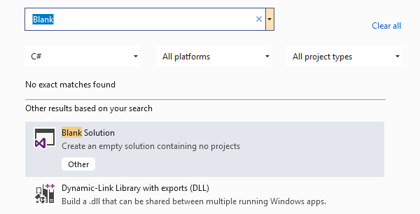
Framework 01: Create an Empty Project

Slide 59
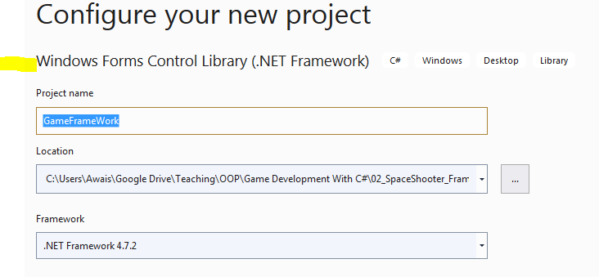
Framework 01: Add Project for FrameWork
We have to use some graphical control such as picture box therefore the type is easier for reference management

Slide 60
Framework 01: GameObject class
we need to create a class that allows game objects to define
Attributes (such as pictureBox, Movement Speed)
Behavior of the game object (Movement Direction Etc).
An Update method that will update the game object at every tick.

Slide 61
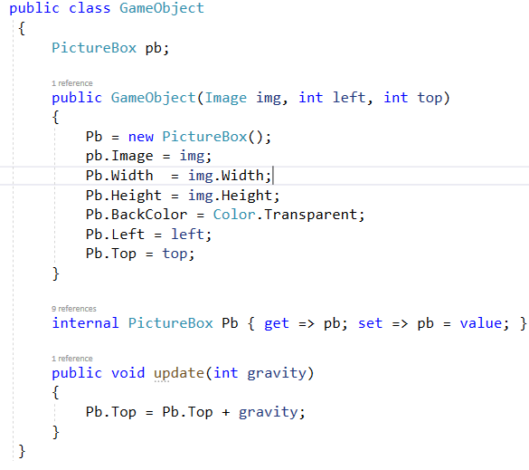
Framework 01: GameObject class

Slide 62
Framework 01: Game class
Now, we shall create a game class which will provide two services
keep track of all the game objects
Call update method of each game object.

Slide 63
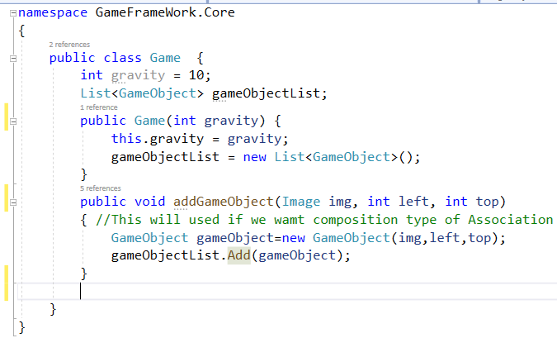
Framework 01: Game class

Slide 64
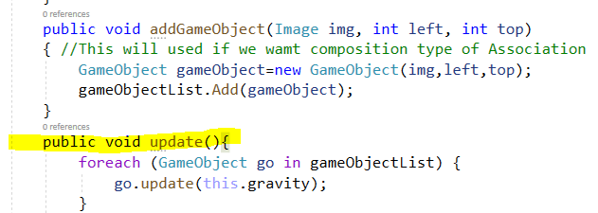
Framework 01: Game class
Way to provide Update all game objects. Add update function in game class that subsequently call update function of all of it s game objects

Slide 65
Framework 01: Game class
Now, one more thing is left in our game framework that these game Objects are in ram but they are not graphically shown on the form.
How can Game class can show/add these objects on the form ?

Slide 66
Framework 01: First Approach
How can Game class can show/add these objects on the form ?
1. Pass form object reference to Game so when it will create gameObject all add that into the form
Game g = new Game(10, this);
g.addGameObject (meteoroid,10,20);
Inside the addGameObject
//code to add game object
container.Controls.Add(g.getPictureBox())
ANY PROBLEM ?

Slide 67
Framework 01: Second One
How can Game class can show/add these objects on the form ?
2. Create Gameobject from the Form and also add the picture box of the game Object into the Form. The could will look like this
Game g = new Game(10);
GameObject go1 = new GameObject (meteoroid,10,20)
g.addGameObject(go1);
this.Controls.Add(g.getPictureBox())

Slide 68
Framework 01: What we want
How can Game class can show/add these objects on the form ?
The problem with the second approach is sometimes we need to create the objects from within the framework and it is not always necessary that the main form has that object.
Also we do not want to pass the GUI (Form) reference to framework.
So how to combine these two approaches to get the required result ?

Slide 69
Framework 01: Event Based
How can Game class can show/add these objects on the form ?
Third approach is to add an event in the game class and when any game object is added, the event should raised and the form will handle this event to add the newly added object into the forms control.

Slide 70
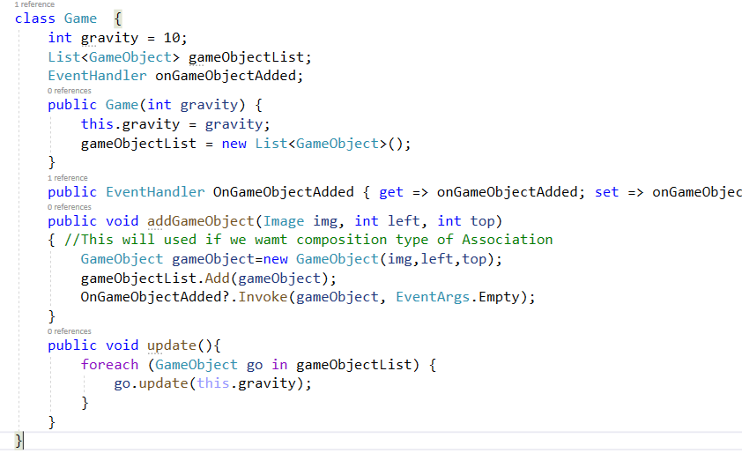
Framework 01: Event Based

Slide 71
Framework 01: Consumer Game
Now, let's consume this framework and see how easier the things are for developer.
What will be the steps ?

Slide 72
Framework 01: Consumer Game
To consume the framework follow these steps:
Create a windows form project and add reference to framework
In Consumer Project add Images into the Resources.
Set the background color of the form.
Make the form’s project as startup project
Add timer on the form
In Main Load Event create main instance of game and add different game objects.
Handle OnAddGameObject event of the game to add pictureBox of the gameObject into the form controls .
In time Update call the update method of game,

Slide 73
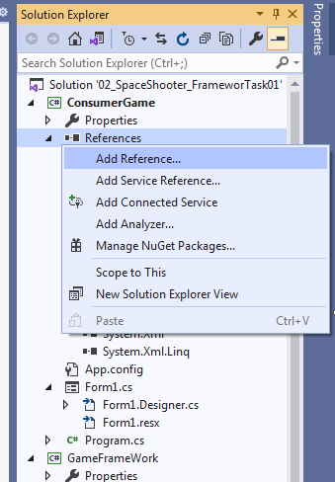
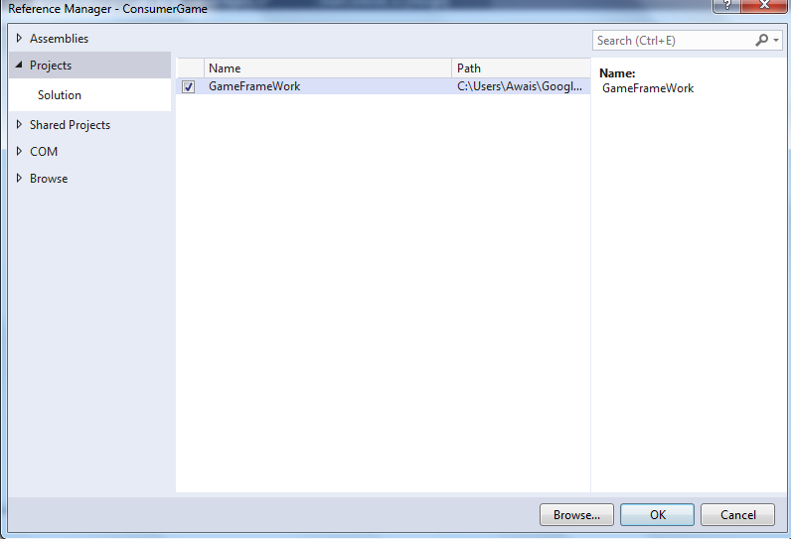
Framework 01: Consumer Game
Create a windows form project and add reference to framework.

Slide 74
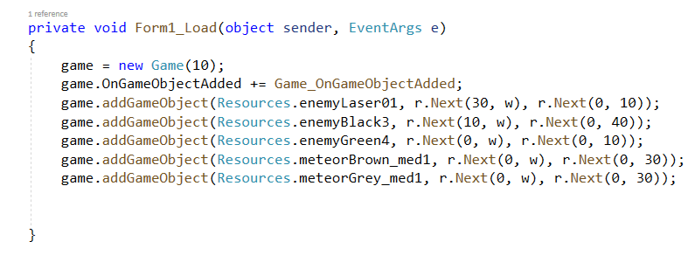
Framework 01: Consumer Game
Form Load will look like following

Slide 75
Framework 01: Falling Under Gravity
Within Timer Tick, we need to call the update method of our game object. May be like following..
game.update()

Slide 76
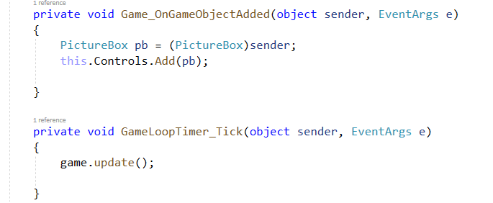
Framework 01: Consumer Game
On Tick Event of main game loop and onGameObjectAdded

Slide 77
FrameWork Task 02 (Take Home)
Now extend the framework such that it allows developer to move any object using three types of motions
Move Vertically (Falling)
Periodically Move Left Right
Move through KeyBoard
Note: we want the user of framework only decide the images of objects and type of motion for an object only. All other code should be inside the framework as separate DLL file

Slide 78
FrameWork Task 03 (Take Home)
Your framework should be developed in a way that if user of your framework want to extend the behaviour of the motion then it could do that easily without opening the code of the framework
For example user of the framework want to move an object zig zag or diagonally then it only need to write the code for this movement and then inject into your framework so now framework allow gameobjects to move diagonally. (Note this change will only for the user)

Slide 79
Spring 2021 Code
Using C# and WinForms
Notes:
Welcome to our new course on Python.

Slide 80
Falling Under Gravity.
First,we need to add timer. This timer tick will serve as main game loop that should be atleast call 50 time within a second.
To achieve this you can set the timer tick to 100 millisecond (time depend on the complexity of the game).

Slide 81
Falling Under Gravity.
First,we need to add timer. This timer tick will serve as main game loop that should be atleast call 50 time within a second.
To achieve this you can set the timer tick to 100 millisecond (time depend on the complexity of the game).

Slide 82
Falling Under Gravity.
Now, in each timer tick, you can check the input from the keyboard and move the player picture box according to the keyboard input.

Slide 83
Falling Under Gravity.
private void timeMainGameLoop_Tick(object sender, EventArgs e)
{
//gravity is global variable with value 3 you can experiment
//with different values
pbPlayer.Top = pbPlayer.Top + gravity;
}

Slide 84
Falling Under Gravity.
Problem: Let we need to add falling functionality for different objects (picture box) such as enemies and other players.

Slide 85
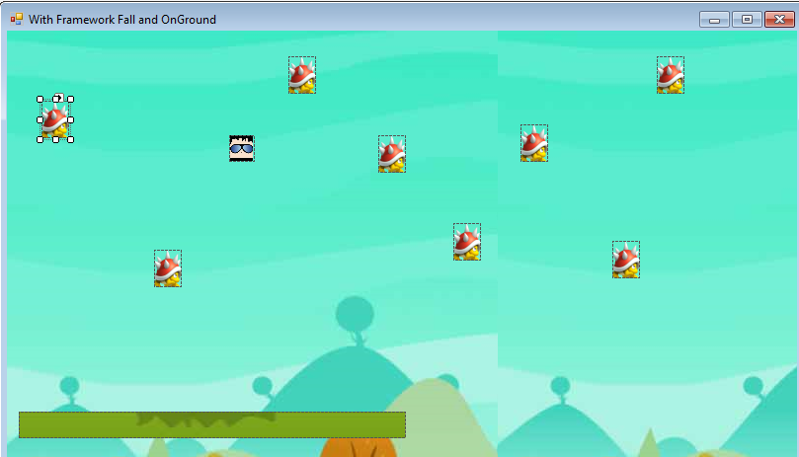
Falling Under Gravity.

Slide 86
Framework 01: Falling Under Gravity.
Problem: Let we need to add falling functionality for different objects (picture box) such as enemies and other players.
Solution Requirements:
We need to create a game framework that can be used by the other developer to make their picturbox fall under gravity.

Slide 87
Framework 01: Falling Under Gravity.
Solution Requirements:
The game design (picture boxes) should be separate.
There should be separate business logic from the form.

Slide 88
Framework 01: Falling Under Gravity
How to do that ?

Slide 89
Framework 01: Falling Under Gravity
First thing is to visualize if you are user of the framework and how will you want to use it ?

Slide 90
Framework 01: Falling Under Gravity
There should be some way that the developer tell the framework that the specific picture box shall act as falling object.
Also, there should be a way to repeatedly update the position of the all the falling objects.

Slide 91
Framework 01: Falling Under Gravity
DO IT YOURSELF

Slide 92
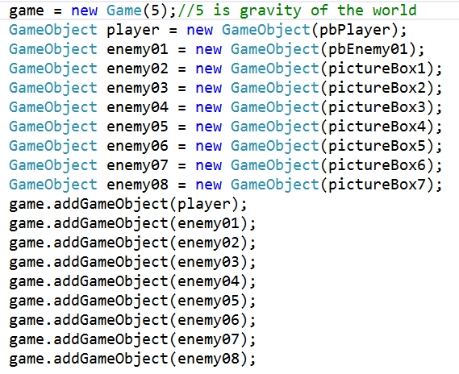
Framework 01: Falling Under Gravity
This is load method of form. The Game and GameObject are the classes the frame work. Picture Boxes are drawn at form.

Slide 93
Framework 01: Falling Under Gravity
Within Timer Tick, we need to call the update method of our game object. May be like following..
game.update()

Slide 94
Discussion on Task 01
Let see some attempts and mistakes.

Slide 95
Framework 01: Writing Demerits

Slide 96
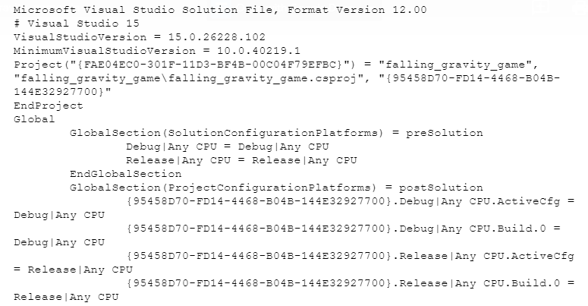
Framework 01:

Slide 97
Framework 01: Writing Demerits
A good Example (Umair)
Demerits of the procedural solutions are that we need to control the each object of the game individually. It is very hard to control each object location and move it on the screen if our game contain more number of objects it becomes very complex to handle and number of code lines may also increase with this approach.

Slide 98
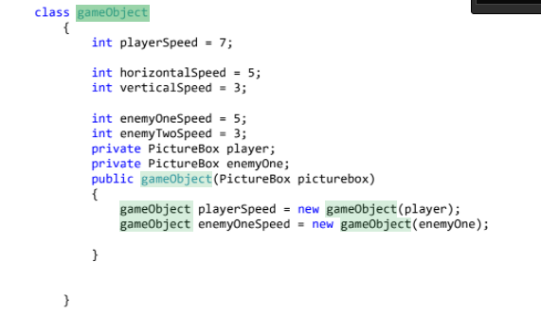
Framework 01:
One object represent one real time entity.

Slide 99
Framework 01:
No need for extra functionality. Only post what has been given

Slide 100
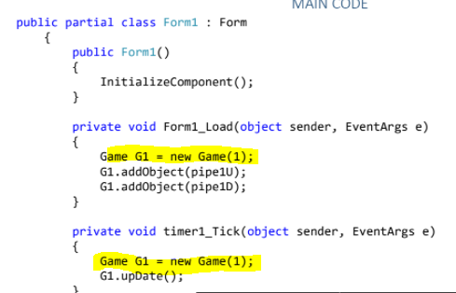
Framework 01: Create a Single Object
Notes:
In this example, two separate object of the game has been created. Objects was added into a separate game object and update is called for a separate game object. You can use global variable and initialize it in the load event.

Slide 101
Framework 01: Create a Single Object
How can framework restrict creation of multiple game objects ?
Notes:
In this example, two separate object of the game has been created. Objects was added into a separate game object and update is called for a separate game object. You can use global variable and initialize it in the load event.

Slide 102
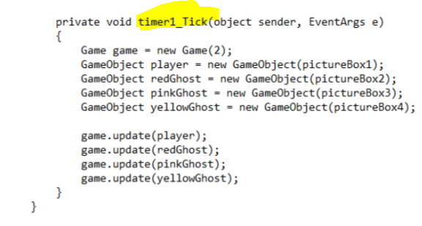
Framework 01: Object at every timer tick
Notes:
In this example, two separate object of the game has been created. Objects was added into a separate game object and update is called for a separate game object. You can use global variable and initialize it in the load event.

Slide 103
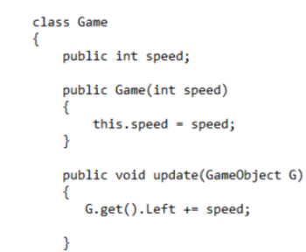
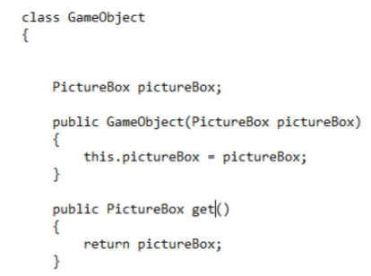
Framework 01:
Functions should be in the class where are the attributes
Notes:
In this example, two separate object of the game has been created. Objects was added into a separate game object and update is called for a separate game object. You can use global variable and initialize it in the load event.

Slide 104
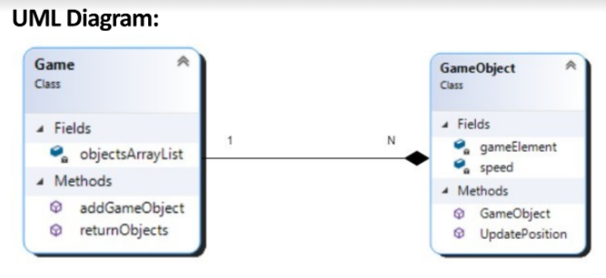
Framework 01:
Functions should be in the class where are the attributes (A better approach-Taken from Afzal document)
Notes:
In this example, two separate object of the game has been created. Objects was added into a separate game object and update is called for a separate game object. You can use global variable and initialize it in the load event.

Slide 105

Framework 01:
Multiple Movements (Huzaifa) use enum

Slide 106
Framework Task 02
Notes:
Welcome to our new course on Python.

Slide 107
Framework 02:
now, we need to make the motion of game objects dynamically, such that we should be able to create different movement behaviours and add into our game object and that gameobject start moving with it. If we do not provide the movement behavior the default behaviours should be to move left.

Slide 108
Framework 02:
The Load event of form shall look like following.
GameObject player = new GameObject(pb1,2,new MoveWithKeyBoard());
GameObject Enemy1 = new GameObject(pb2,3,new MoveLeft())
GameObject Enemy2 =new GameObject(pb3,5,new MoveLeftRight())
//any number of object
Game g=Game.getInstance();
g.add(player);g.add(Enemy1);g.add(Enemy2); // add remaining objects
/*MoveWithKeyBoard,MoveLeft and MoveLeftRight are the classes.if the junior develop want to add new movement behaviour like MoveRight he should follow some guideline and develop a new class that allow objects to start moving right side without any change in the framework.*/

Slide 109
Framework 02:
The Timer Tick Event should look like following.
g.update();

Slide 110

Framework 02:
The update method of the game class shall look like following.
/*the game.update shall call update method of the game objects that shall move the object automatically according to the movement behaviour.*/

Slide 111

Framework 02: One Possible Solution

Slide 112

Framework 02: One Possible Solution

Slide 113

Framework 02: One Possible Solution
Notes:
Here we can improve the method,instead of passing the left or right we can pass directly the instance of class.

Slide 114

Framework 02: Another Possible Sol
Notes:
Here movement class is abstract class.

Slide 115


Framework 02: Another Possible Sol
Notes:
Here we can improve the method,instead of passing the left or right we can pass directly the instance of class.

Slide 116
Framework 02: Another Possible Sol
Can we improve it further ?
Notes:
Yes we can with interfaces

Slide 117
Framework 02: Another Possible Sol
Yes we can do it with interfaces
Notes:
Yes we can with interfaces

Slide 118
Framework 02: Task Detail

Slide 119
Framework 02: Important Concepts Covered so Far
Singleton Pattern (Single Instance of Game Class)
Composition
Composition vs Inheritance
Abstraction vs non Abstraction
Abstract vs Interfaces.

Slide 120
Framework 02: Task Detail

Slide 121
Framework Task 03
Notes:
Welcome to our new course on Python.

Slide 122
Framework 03: Part 01
The first part of the task is to update the Task 02 with Interface and Composition.
Add Four Movement Behaviours
MoveLeft,
MoveRight,
Petrol
KeyBoardControl

Slide 123
Framework 03: Part 02
We need to make the game object such that framework could answer how many Game object of any type exists.

Slide 124
Framework 03: Task Detail
2. Finally we want to display total enemies on the top bar.

Slide 125
Framework 03: Task Detail
Remember your task is to facilitate developer. The game should take control of its counting of objects rather than burden on the developer.

Slide 126
Framework 03: Hint
Do it Using:
Enum and Factory Pattern

Slide 127

Framework 03: Solution
We can provide mechanism through enumeration that allow use to select the type of player

Slide 128

Framework 03: Solution
We can provide mechanism through enumeration that allow use to select the state of the player

Slide 129

Framework 03: Solution
Now, we can extend the game object constructor and ask user to provide both state an type along with picturebox

Slide 130
Framework 03: Solution
Finally, to keep track of created game objects we need to give this responsibility to game object.
Means now we are converting aggregation relation to composition relation between game objects and game class.

Slide 131

Framework 03: Solution
In Game class we shall create the function create game object.

Slide 132
Framework 03: Solution
Also, we need to change the load method of form now the game object will be created through main game object

Slide 133

Framework 03: Solution

Slide 134
Framework Task 04
Class Library
Notes:
Welcome to our new course on Python.

Slide 135
Framework 04: Problem with Factory
We made the factory pattern so it keep count of the GameObjects that has been created.

Slide 136
Framework 04: Problem with Factory
But problem is that the Game Develop who is using the framework can create the game object without calling the factory pattern and it can add that game object to the game .
Therefore in this case Factory pattern will be failed.

Slide 137
Framework 04: Problem with Factory
Any Solution

Slide 138
Framework 04: Problem with Factory
One solution is you can Extend the Factory class from GamebObject Class and make the constructor of the GameObject protected
So only factory class can create the object of GameObject

Slide 139
Framework 04: Problem with Factory
This solution is not ideal forr two reasons
Factory is not Game Object but we are making it
Secondly again if the game developer create a new Class and Extend that class from GameObject then he can create the obect

Slide 140
Framework 04: Problem with Factory
So we need more robust solution.

Slide 141
Framework 04: Problem with Factory
If we want to allow the access of some classes, constructors, functions or attributes to some sepecific classes than we can set their access modifier to internal and put the classes into same assembly.
All other classes those are not within the assembly can not access this class if it interneal

Slide 142
Framework 04: Separation of Projects
Also, It's time to make your framework independent from the Game. You need to put all classes related to game framework into a dll file and then add that dll file into the game project.

Slide 143
Framework 04: Class Library
For this you have to create two project.
One Project will be of Type Class Libary. This project package all of the class related to the framework
Another Project will be of type GUI windows form and it shall contain your game. This game project shall add the Class project as reference.

Slide 144
Framework 04: Class Library
Your task is to separate the Game from the GameFramework so in future it can be shipped to Game Developers.

Slide 145
Framework 04: Class Library
Your task is to separate the Game from the GameFramework so in future it can be shipped to Game Developers.

Slide 146
Framework 04: Class Library
Also, Make the GameObject class such that its object can not be created outside of the DLL (Assembly) and Problem of counting that we raise in factory pattern is solved.

Slide 147
Framework Task 05
Collision Detection
Notes:
Welcome to our new course on Python.

Slide 148
Framework Task 04
Now, we need to detect the collision between any two types of the objects and on collision we want to attach the behaviour.
For example, we want when a collision occur between player and ground the player shows stop behaviour means it stop falling.

Slide 149
Framework Task 04
Another example is when the enemy touch with the ground we want that it shows moving toward left behaviour.

Slide 150
Framework Task 04
We want the framework should be extendable such that the junior developer can add collision between any two types and also can create its own behaviours and add to the game.
At the moment, we are interesting to give to behaviour StopWhenHitOnGround, and MoveLeftWhenHitOnGround

Slide 151
Framework Task 05
Notes:
Welcome to our new course on Python.

Slide 152
Falling Under Gravity
Now, we need our player to stop following when it land on the ground.
private void timeMainGameLoop_Tick(object sender, EventArgs e)
{
if (!isOnGround)
{
pbPlayer.Top = pbPlayer.Top + gravity;
}
isOnGround = false;
if (pbPlayer.Bounds.IntersectsWith(pbGroundZero.Bounds)) {
isOnGround = true;
}
}

Slide 153
Problem
Again next scenario will have different option, In this way the loop will keep executing and the game will end in failure or success.

Slide 154
Problem
The task is not to develop a game. Instead the task is to develop a Framework (set of a class or multiple classes) that allow other developers to easily develop the game.

Slide 155
Problem
Easy may have many means you can come up with you own ease that you want to give to other fellow developers.

Slide 156
Problem
The minimum requirement is developer only define the scenarios, options to scenarios and link multiple scenarios with each other.

Slide 157
Problem
Use the OOP principles to make things more extensible and maintainable.

Slide 158
Submission Requirement
Class Diagram.
The Framework Code.
The Example Adventure Game using the Framework.
A written document which clear mention which object oriented programming concepts you have used to implement the Framework and WHY

Slide 159
Some story links
https://www.choiceofgames.com/dragon/scenes/queenpolitics.txt
https://www.choiceofgames.com/dragon/scenes/startup.txt

